Slide 1
Introduction
What did we do?
What was the aim?
Why did we do it?
Notes:
The assignment was created on the idea of game-based learning as an approach to educational learning that uses digital games and applied sciences to improve teaching and learning.
The aim of this project was to design a mobile game application that provides mathematical exercises to children from grade 2 to grade 8.
The game contains rewards and surprise elements to help maintain kids' interest in learning, improve brain function, skills, and emotional connection to material.

Slide 2
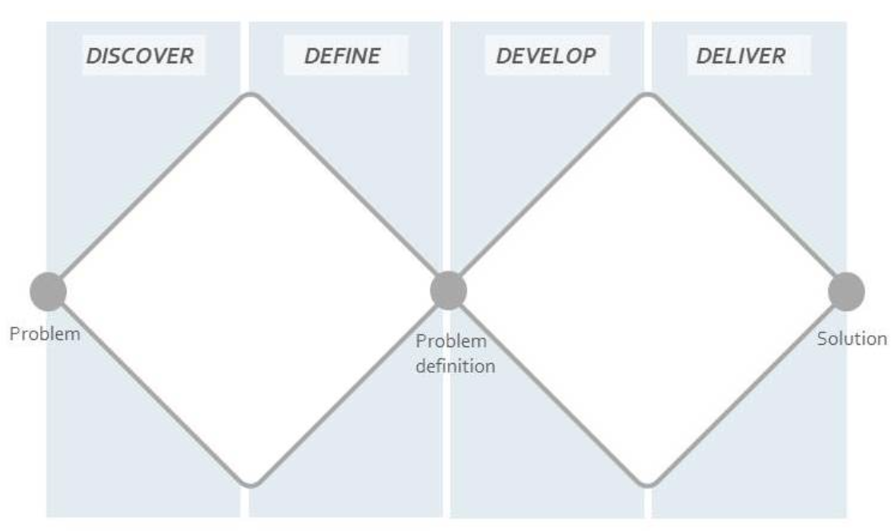
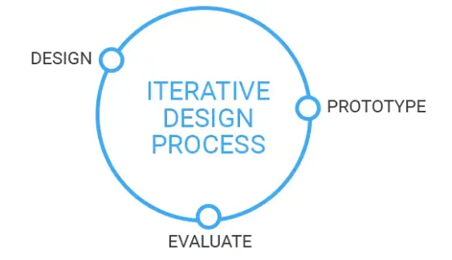
Methodology
Double diamond
Iterative design process
Notes:
As methodology approaches, we have used *->* the Double diamond model, which allowed to approach the design of the product in a structured and systematic way.
By following the four phases for interaction design it helped us understand the problem, needs and goals of the users, generate and explore multiple design concepts, and create a final design solution.
In addition to following the Double Diamond model, we also followed an *->* iterative design process. When problems were identified during user testing, the necessary design changes were made, and then additional testing conducted to assess the effectiveness of changes.

Slide 3
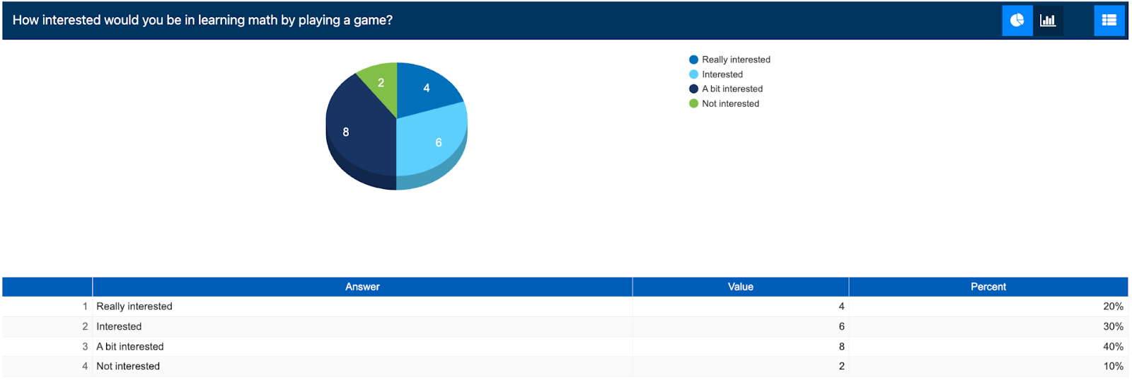
Double Diamond
Discover
Data gathering
Survey
Five key issues
Setting goals
Identifying participants
Relationship with participants
Triangulation
Pilot studies
Notes:
Stating with the discovery phase in the double diamond model, *->* data gathering was done through a survey published in which potential users gave us more information on our idea.
In order to have a successful discovery phase, *->* five key issues of a data gathering have been taken into consideration:
Setting goals – Gathering information about potential users, their educational level, and interest in educational mobile apps.
Identifying participants - through random sampling of close friends and family, as well as internet groups that met the criteria for the survey goals.
In Relationship with participants - The purpose of the study was made clear to all. Sensitive data was not requested, and it was declared that the data would not be shared.
As Triangulation - Data was extracted from individuals from different geographical locations, and of different types (kids, parents, or both answering together).
Pilot study - Was conducted in the form of a interview which later helped shape the main survey.

Slide 4
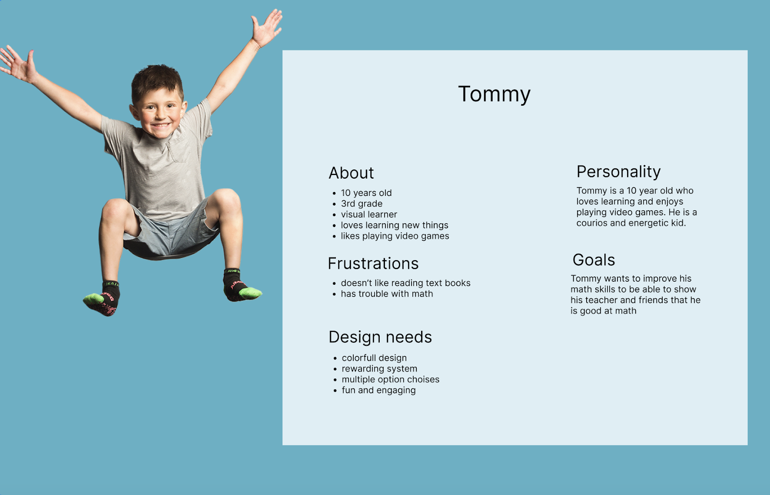
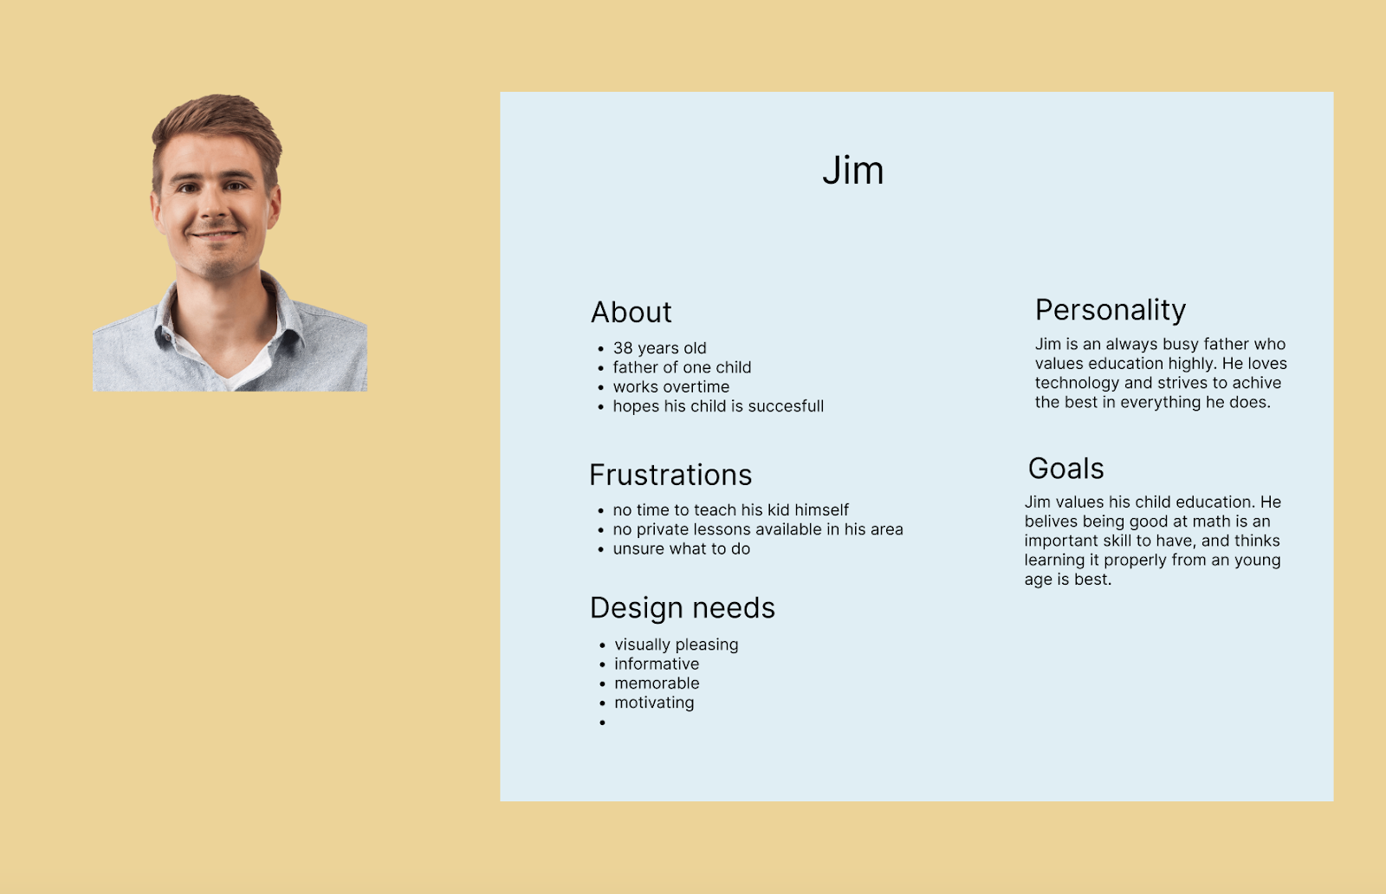
Who is the audience?
Notes:
A step in the design process was defining the audience by creating fictional characters that represent the goals, attitudes, and behaviors of the product users.
We created personas to helps us understand if a functionality or design decision will be beneficial or not to the users.
Personas have two main goals: to guide design decisions and to remind the team that real people will use the product.
Here we have two personas Tommy, who wants to improve his math skills but does not enjoy reading schoolbooks, and Jim, who is a father that values children’s education but has no time to teach them himself or the possibility to hire a private teacher.

Slide 5
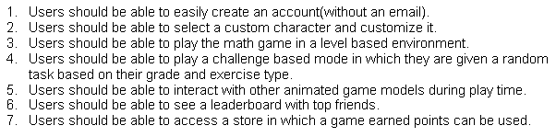
Define
Notes:
From the discovery phase a briefer understanding of the project’s needs has been gained from the user’s perspective.
After data was gathered, the requirements for the application have been decided in the define phase of the project.

Slide 6
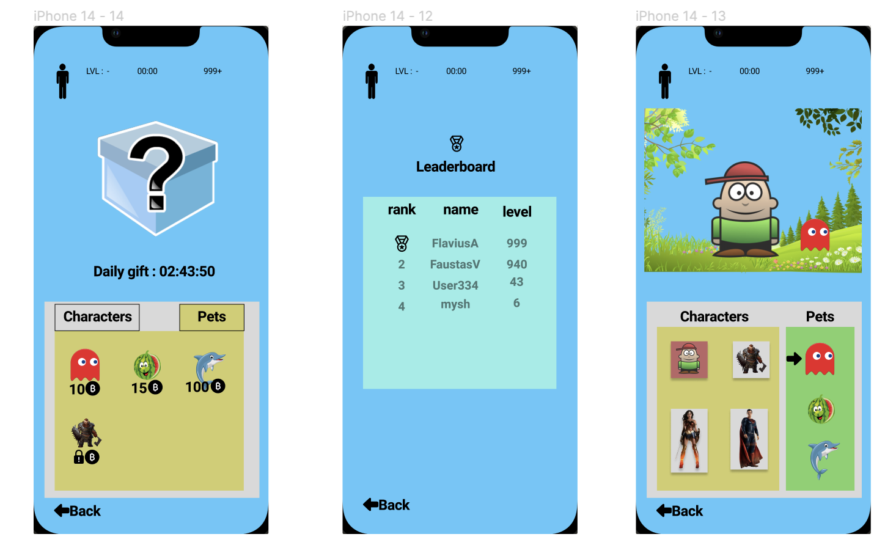
Develop
Visceral level
Behavioral level
Reflective level
Notes:
During the development phase we followed the Emotional Design approach to create a memorable and engaging experience for the user.
The three different “levels” in the model of emotion and behavior are:
The Visceral level where the design features a colorful, playful UI to attract children's attention, and daily notifications with tasks to complete.
The Behavioral level design includes multiple games/challenges to give users more options and keep them entertained.
The Reflective level included a leaderboard to display the most consistent users as well as a reward system.
The Emotional Design also included a focus on Anthropomorphism by having objects with personalities and human-like attributes to make the application more enjoyable to interact with.
The Persuasive technique has a role in making users want to keep coming back to the game. This is done through, notifications about daily usage, skill improvement and potential rewards.

Slide 7
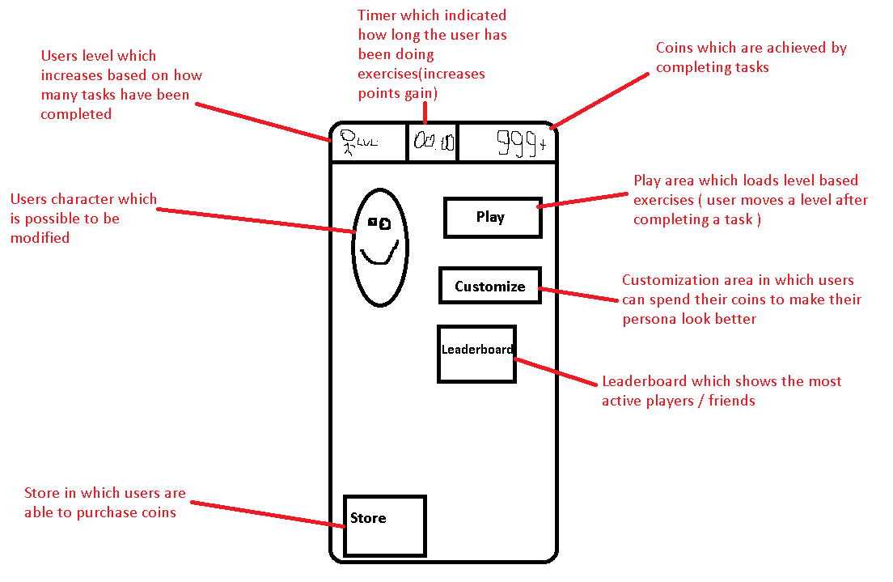
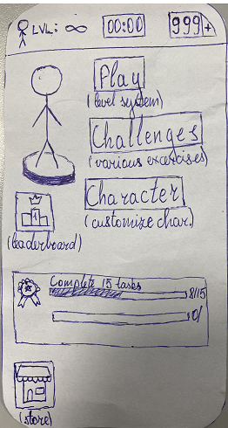
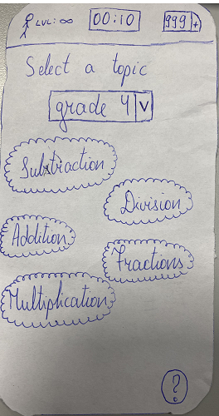
First sketch of the prototype
First physical prototype
First test of the prototype and its results
Notes:
In the development phase a low fidelity prototype was done by drawing a sketch in order to visualize the initial idea and discuss the layout.
Later a physical prototype has been created to allow testing design and functionality of features.
A test process of the prototype included letting the user interact with the game on its own and seeing if the UI is easy to use or if any help is needed in order to navigate through it.
After the test has been conducted, some missing features were reported as feedback and allowed us to improve the design of the game.

Slide 8
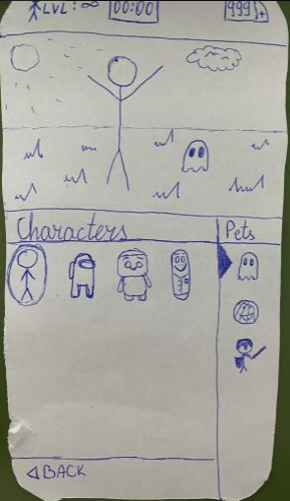
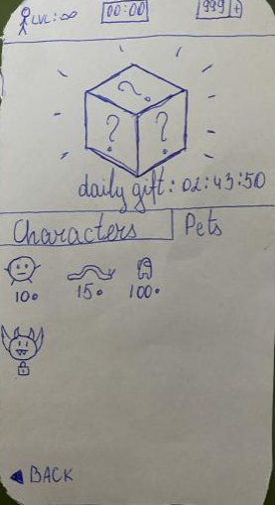
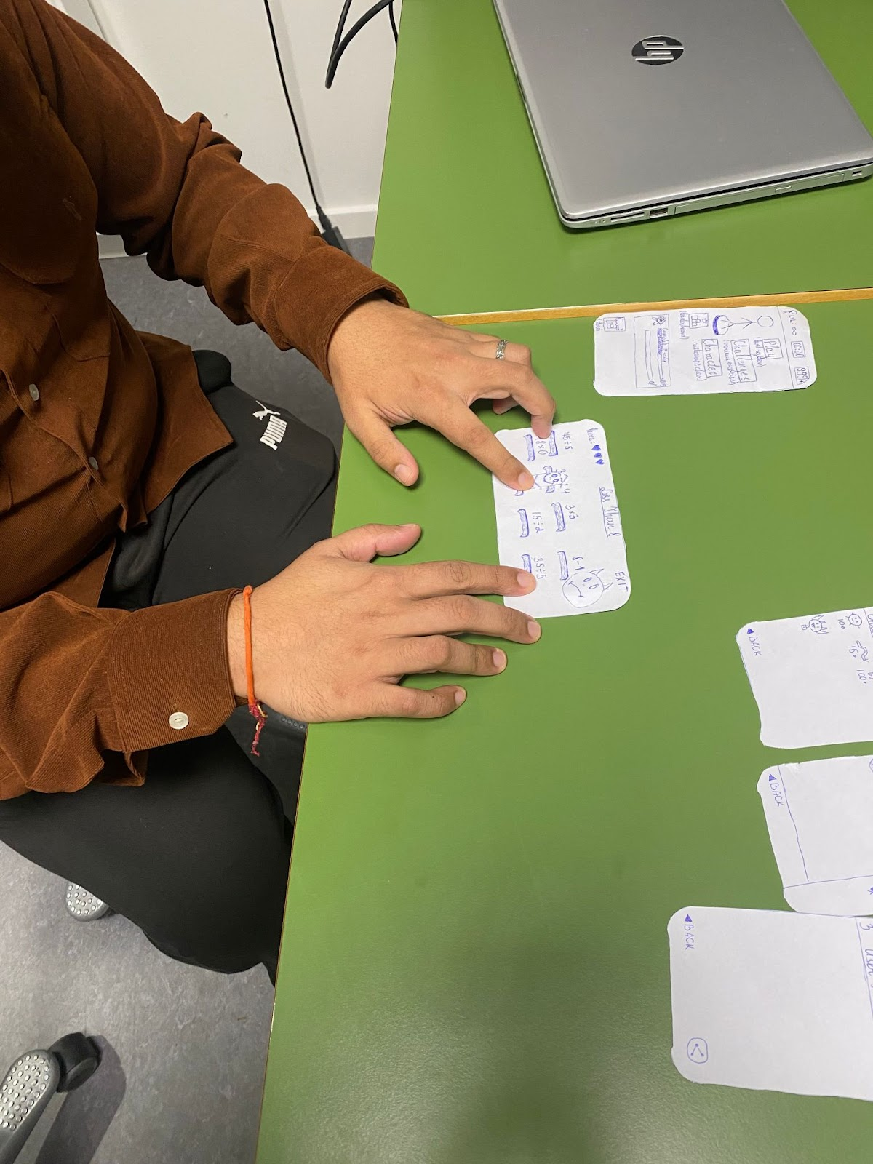
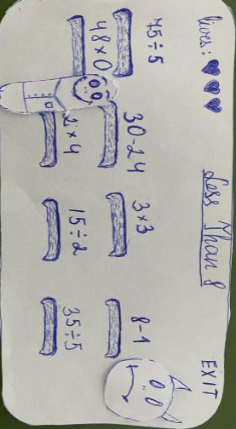
Deliver
Final prototype
Last test case
Notes:
During the Delivery stage the final ideas for the product have been gathered by doing more research on younger audience focused applications, as well as trying to figure what the Math game can do differently compared to the market. Research led to creating different type of game style for different features of the game.
During the final test case, the users were given basic information about the application as well as given both a sketched prototype and a high-fidelity digital one. Test resulted in in adding a timer feature, which forces the user to make a move or pick an answer which added a more thrilling user experience.

Slide 9
Discussion
Notes:
By working on this assignment, we gained useful insights into the design process
From researching, prototyping, and refining.
We are aware though that the interaction design process could’ve been extensively expanded upon, including in-depth analysis, design, and study.

